Slide 1
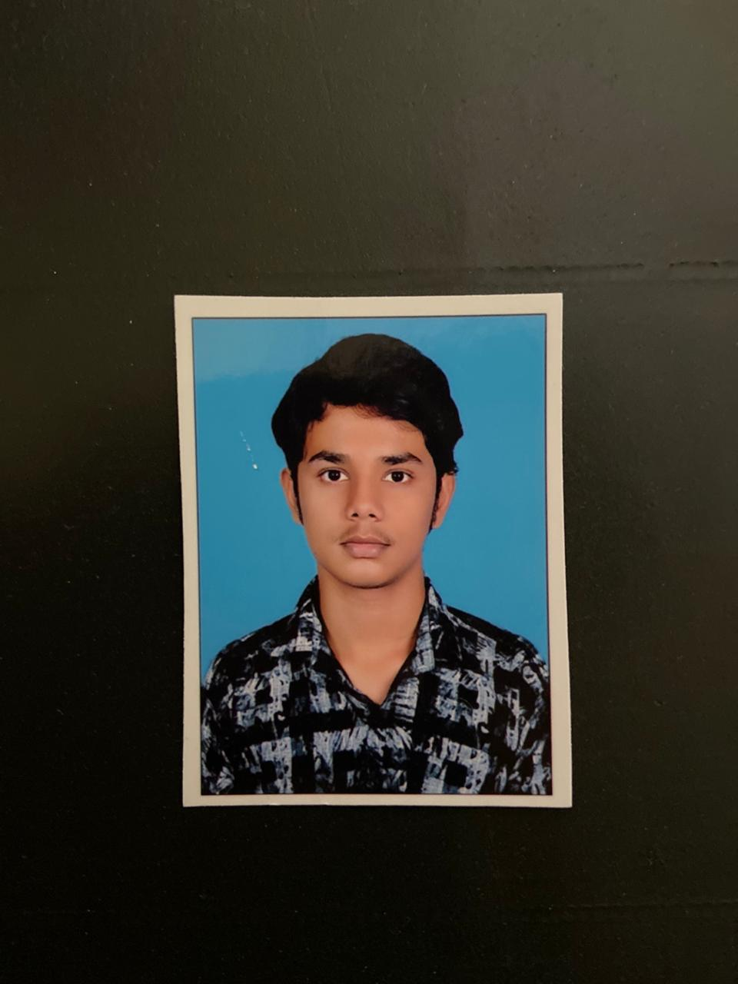

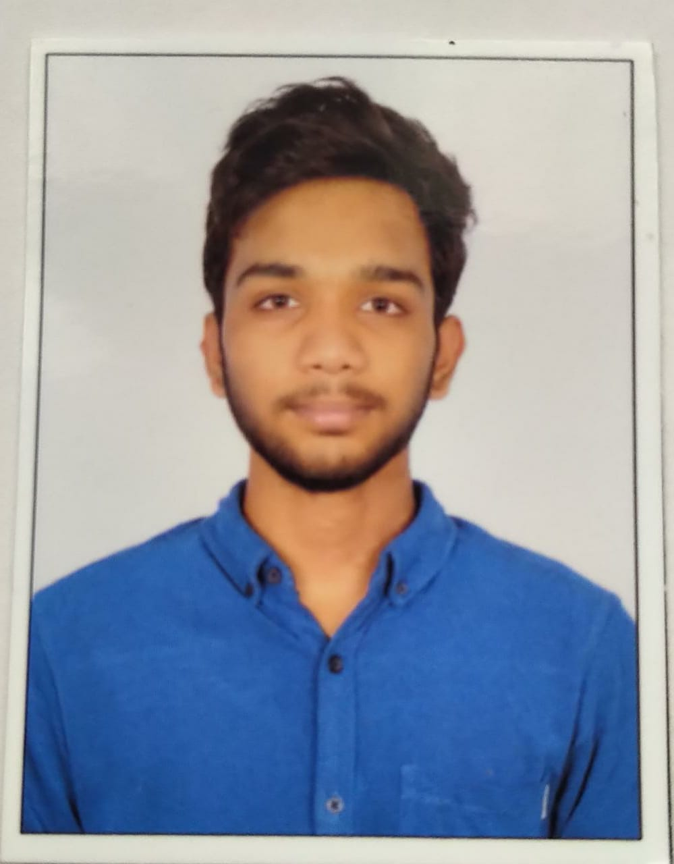
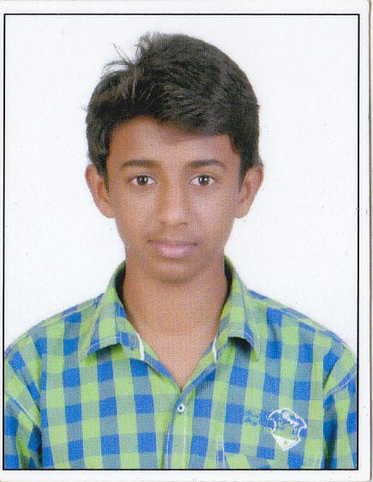
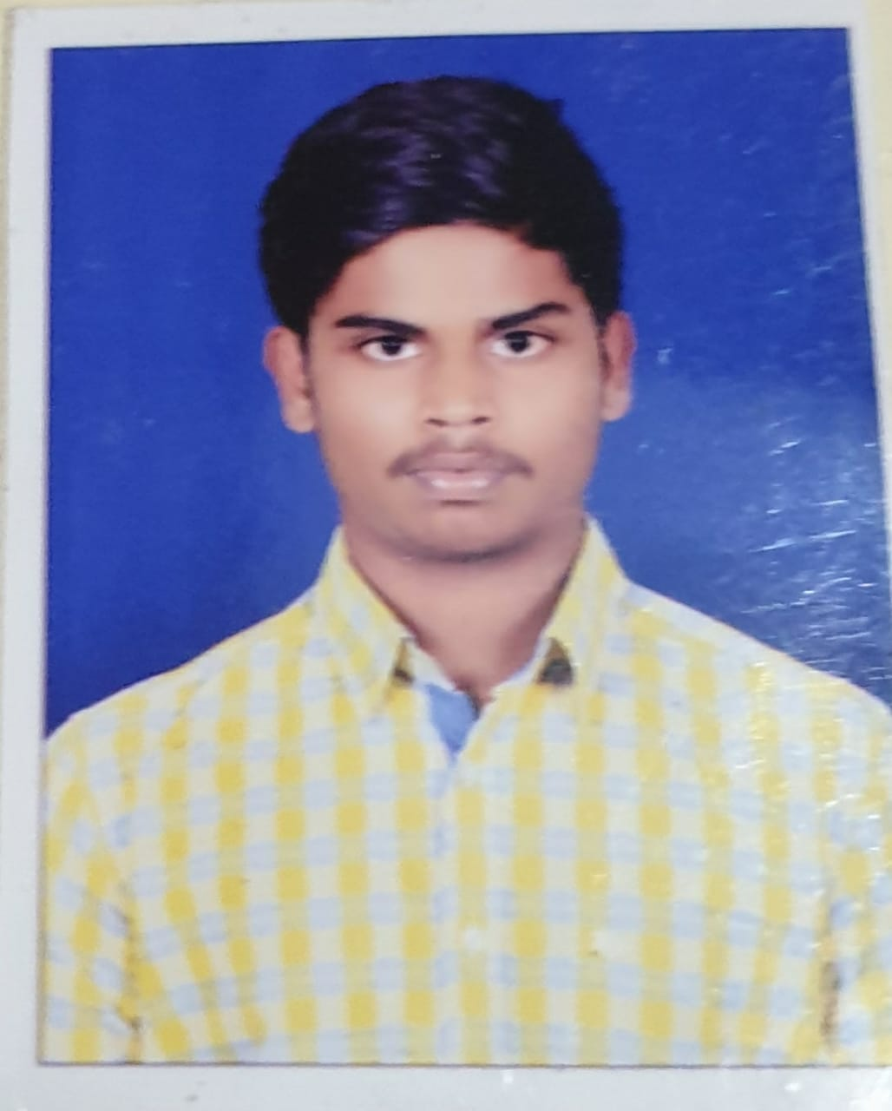
SPHOORTHY ENGINEERING COLLEGE
Nadergul , Rangareddy
NEWGEN IEDC
INTELLIGENT PROCTOR
TEAM MEMBERS
G.Sai charan
18N81A05N7
R.Manish
18N81A05P1
C.Rohith
18N81A05P5
B.Praneeth
18N81A05A6

Slide 2
Problem Statement :
Due to the pandemic, Many universities and organisations are planning for virtual examinations. Which brought an requirement of Artificially Intelligent Examiner to monitor each and every student.
Because an examiner might face difficulty in monitoring students virtually. An Intelligent program can do the task.

Slide 3
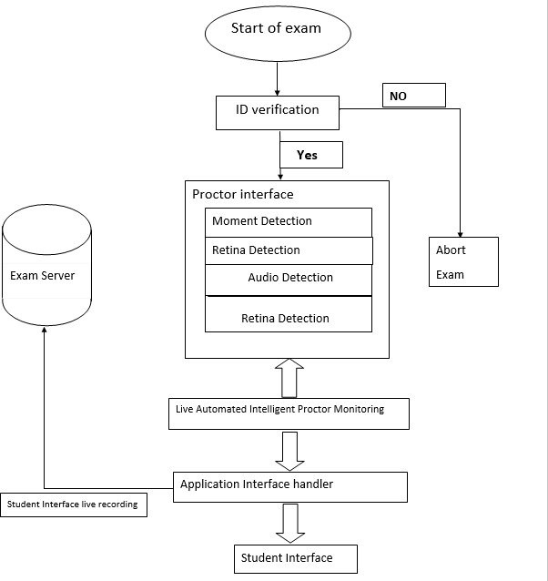
BLOCK DIAGRAM

Slide 4
INTELLIGENT PROCTOR: The Artificial Intelligence based proctoring makes an automation to prevent malpractice while conducting online examinations.
Steps involved in working of the software
Student authentication
Application interface
Moment detection
Retina detection
Object detection
Audio detection

Slide 5
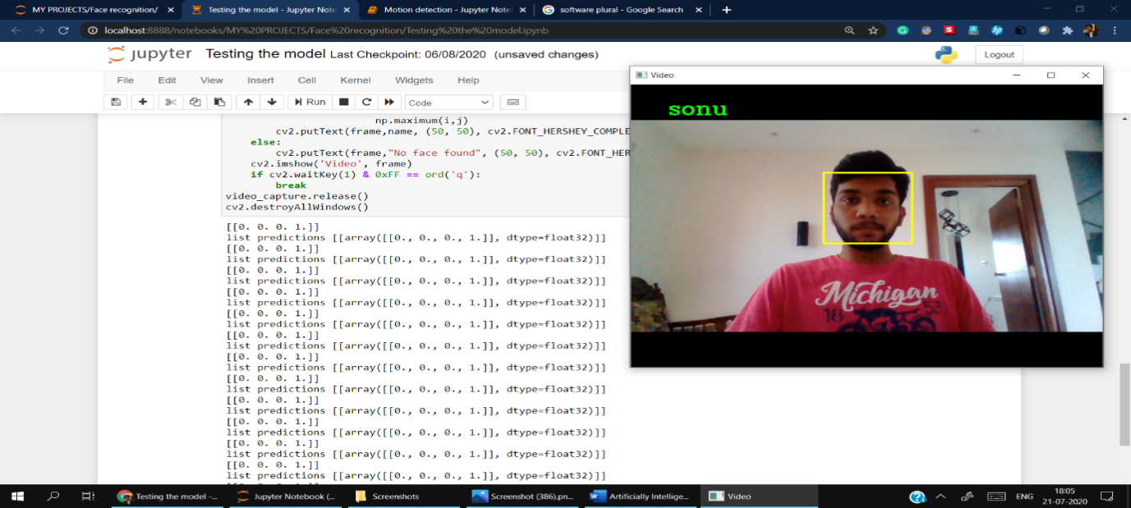

Student Authentication
The authentication is done by
2-step verification from their contact number, followed by id verification.
ID Verification:
We use facial recognition implementing through neural networks for verifying their identification.

Slide 6
Face Detection

Slide 7
Moment Detection
When the exam starts,
Initially audio, moment detection software
will be running in backend.
If there is any moment in the frame i.e
more than threshold (60%) then
Retina detection
Object detection
will start working and prompting a warning
“YOU ARE UNDER SURVEILLANCE”

Slide 8
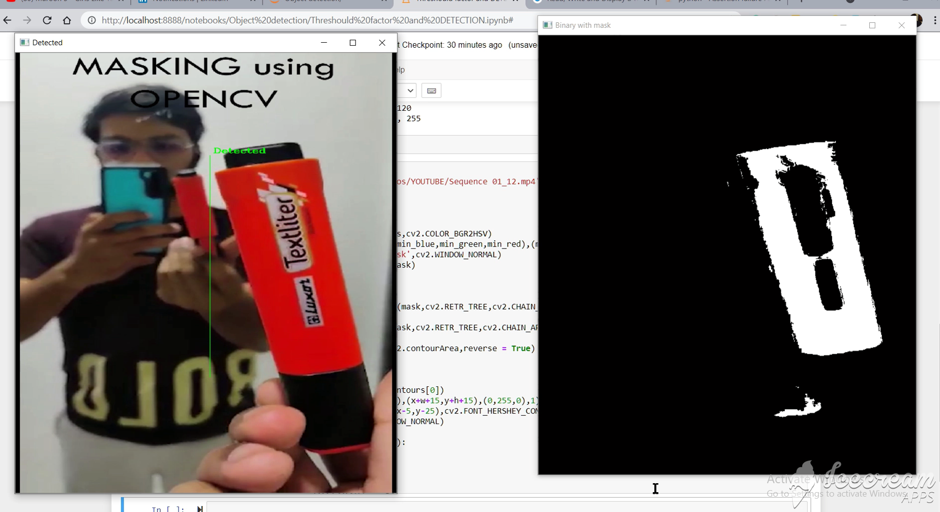
Color Masking

Slide 9
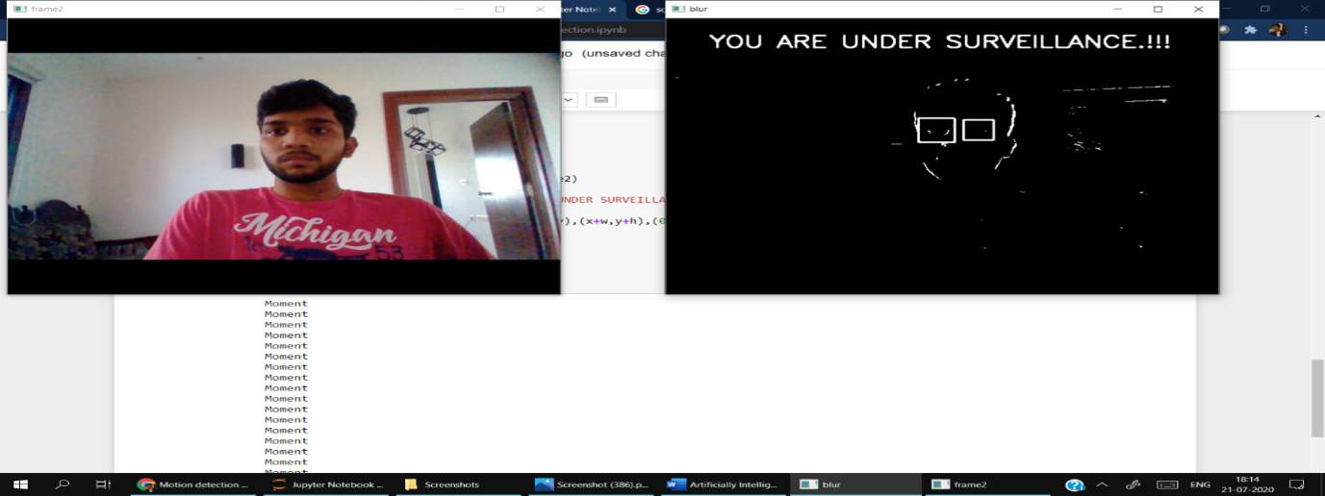
Retina detection
The retina detection will start identifying any unusual movements in the eyes i.e looking outside the screen(frame) to perform malpractice.
The screenshot demonstrates the practical implementation of artificially intelligent moment detector

Slide 10
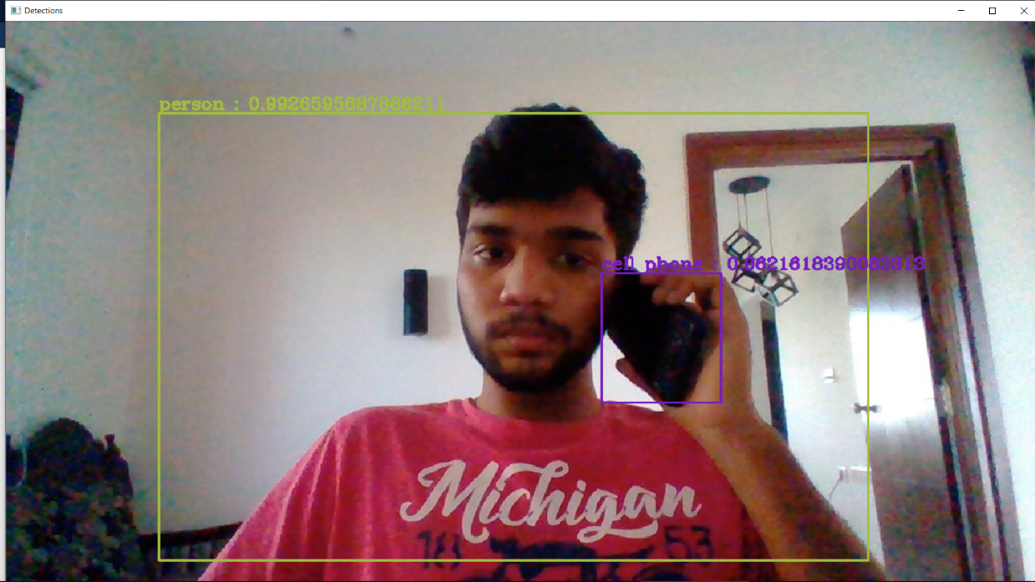
Object Detection
The object detector will perform detection for object which get in contact with student.
If the object is detected as any electronic device used for malpractice then the exam for them is terminated immediately.

Slide 11
Thank you
Team Details
Team Members
1) Rapolu manish
+91 6303618397
manishinred5559@gmail.com
Github Link: https://github.com/manishreddy07/IEDC
2) C.Rohith
+91 7330884025
rohith.chilukuri@gmail.com
Github Link: https://github.com/rohith4025/NewGen-IEDC.git
3) B.Praneeth
+91 91008 61742
praneeth786333@gmail.com
Team Name : Brainiac
Team Captain Name: Gadi sai charan
Team Captain Mobile No: 6281270645
Team Captain Email:
saicharansonu2000@gmail.com
No of Team members : 4

